Slide 1


PANIMALAR ENGINEERING COLLEGE
Department of Computer Science and Engineering
CS8811 PROJECT WORK
VARICOSE VEINS DISEASE DETECTION AND AUTOMATED TREATMENT USING BAN (BODY AREA NETWORK)
Mr.M.MOHAN,B.E.,M.Tech.,(Ph.D.), SUPERVISOR ASSISTANT PROFESSOR GRADE I
PRAVEEN KUMAR.K [211419104198] SUNDARESWAR.N [211419104274] VISHNU.M [211419104308]
Batch Number: C02

Slide 2
INTRODUCTION
The transfer of health monitoring data from multiple patients using wireless body-area networks requires the use of robust, and energy and bandwidth efficient multiple- access schemes. This paper considers the frequency-division multiple access for the wireless uplink to a fixed access point when using infrared signals to collect medical data from several patients inside an emergency waiting room. The conventional optical orthogonal scheme applies Hermitian symmetry to obtain real valued signals, which implies increased computational complexity. We consider a new approach transmitting only the real part of a complex-valued signal, where no such constraints imposed. Based on the proposed scheme, and considering the limited dynamic range of an infrared light-emitting diode, we study the performance of direct current biased and asymmetrically clipped schemes, and show their advantage in terms of energy efficiency and computational complexity, as compared with the conventional schemes. For instance, we show that by using asymmetric clipping, around 35 mW less transmit power is needed to achieve a bit error rate of 10-3 in the considered scenario.

Slide 3
LITERATURE SURVEY
TITLE | DESCRIPTION | AUTHOR1 | YEAR
1.Radiofrequency ablation of varicose veins in obese patients | Radiofrequency ablation of the superficial venous systems has become one of the mainstays of minimally invasive approaches to varicose veins and chronic venous insufficiency. | O. Shumkov1 , M. Smagin1 , V. Nimaev1 , A. Sadovskii2 | 2018
2.Analysis of Varicose Veins of Lower Extremities Based on Vascular Endothelial Cell Inflammation Images and Multi-Scale Deep Learning | The doctor determines whether there are lesions in the human body through the diagnosis of medical images, and classifies and identifies the lesions and is algorithm based on multi-scale deep learning, called MSDCNN | RUIZONG ZHU 1 , HUIPING NIU 2 , NINGNING YIN 3 , TIANJIAO WU 3 , AND YAPEI ZHAO | 2019
3.Mathematical modeling of varicose veins ultrasound heating | During the last decade less invasive endovenous methods of treatment of lower limb varicose veins (LLVV) have obtained widespread appreciation. According to the simulation results, the frequency range, and the changes of the venous wall can be caused | A. S. Borde, G. V. Savrasov | 2019
4.Comparison of Mechanical Parameters of the Great Saphenous Vein under Various Test Conditions | The mechanical parameters of the human veins are often measured in different test conditions. There are ndifferent test conditions on these parameters to dateo studies on the influence of | Gennady Victorovich Savrasov, Alexander Vasilyevich Gavrilenko, Anna Sergeevna Borde, Nikita Vladimirovich Belikov, Irina Vitalyevna Khaydukova, Irina Alexandrovna Seliverstova | 2019
5.Non-Invasive Capillary Blood Pressure Measurement Enabling Early Detection and Classification of Venous Congestion | we proposed an opto-mechanical system to achieve non-invasive and automatic CBP measurements through modifying the widely implemented oscillometric technique in home-use arterial blood pressure monitors. | Jing Liu, Bryan Yan, Shih-Chi Chen, Yuan-Ting Zhang, Fellow, Charles Sodini, Fellow, and Ni Zhao | 2021

Slide 4
PROBLEM STATEMENT
Varicose veins are a common medical condition that affects millions of people worldwide. It occurs when the veins become enlarged, twisted, and bulging, leading to discomfort, pain, and skin ulcers. Early detection of varicose veins is crucial to prevent further complications. However, the traditional diagnostic methods are invasive, expensive, and time-consuming. Therefore, there is a need for a non-invasive, cost-effective, and accurate diagnostic system for the early detection of varicose veins disease. Body Area Network (BAN) is an emerging technology that allows wireless communication between medical devices worn by the patient and a central monitoring system. BANs have the potential to revolutionize the healthcare industry by providing continuous monitoring and early detection of various medical conditions. Therefore, in this project, we aim to design and develop a BAN-based system for the early detection of varicose veins disease. The proposed system will consist of wearable sensors that will be attached to the patient's legs to measure the blood flow, oxygen saturation, and temperature of the affected area. The collected data will be transmitted wirelessly to a central monitoring system, which will use machine learning algorithms to analyze the data and detect varicose veins disease. The main objective of this project is to design and develop a BAN-based system that can accurately detect varicose veins disease in its early stages, thereby providing timely medical intervention and preventing further complications.

Slide 5
TECHNOLOGY STACK
HARDWARE REQUIREMENTS
POWER SUPPLY
ESP8266
DB18B20 TEMPERATURE SENSOR
I2C LCD MODULE
LCD
ZIGBEE
VIBRATION MOTOR
FORCE SENSOR
ARDUINO
SOFTWARE REQUIREMENTS
ARDUINO IDE
EMBEDDED C

Slide 6
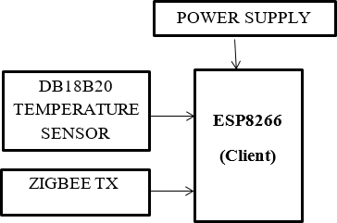
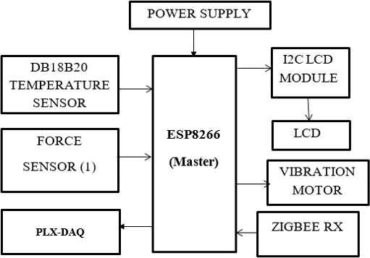
SYSTEM ARCHITECTURE

Slide 7
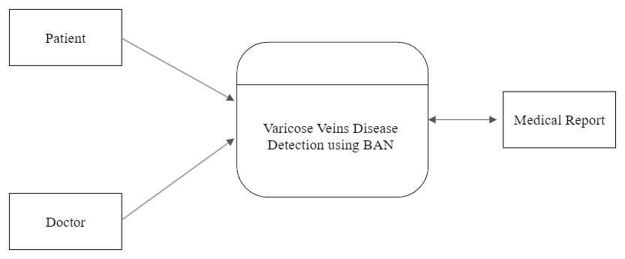
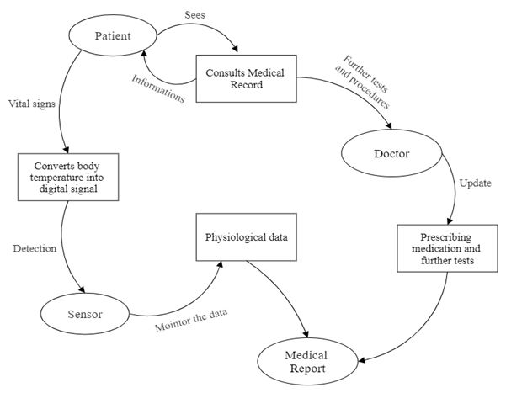
SYSTEM DESIGN
DATAFLOW DIAGRAM
( LEVEL 0 )
(LEVEL 1)

Slide 8
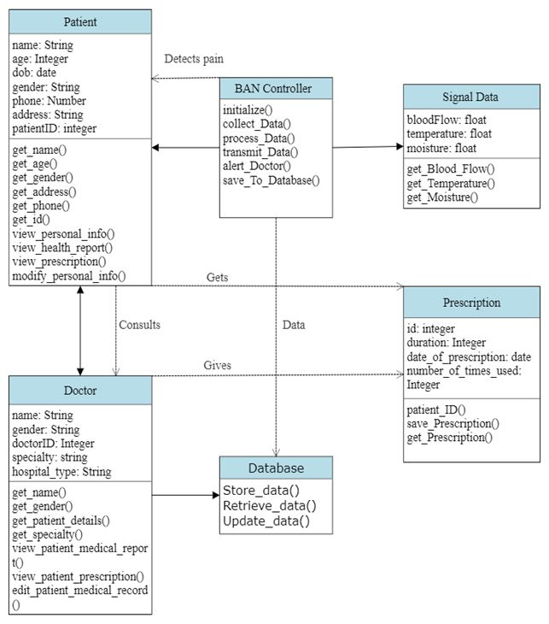
CLASS DIAGRAM

Slide 9
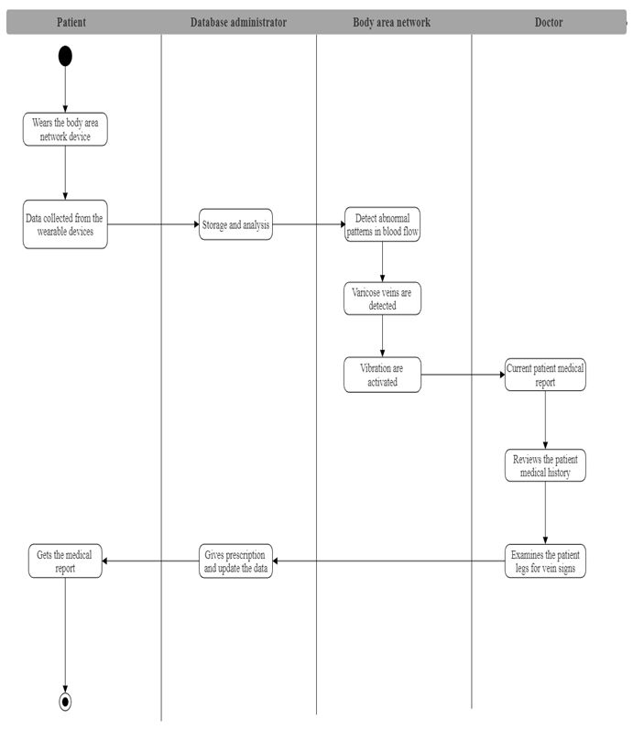
ACTIVITY DIAGRAM

Slide 10
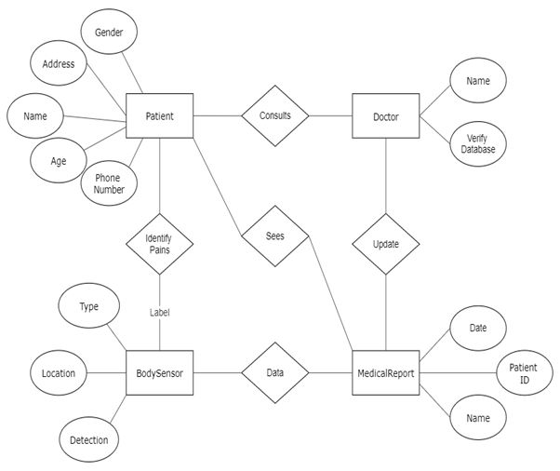
ER DIAGRAM

Slide 11
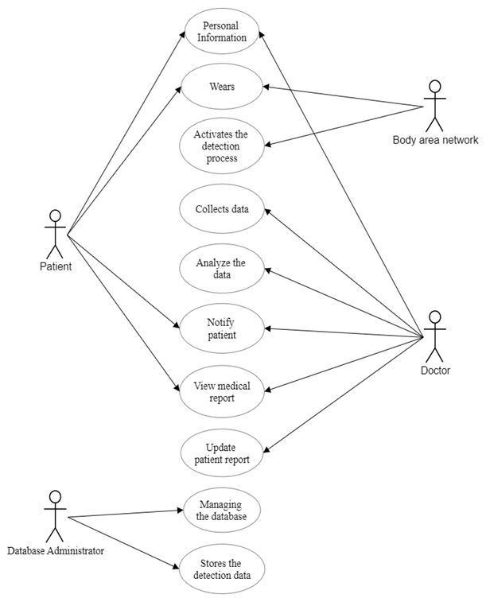
USECASE DIAGRAM

Slide 12
MODULE DESCRIPTION
The delay in adequate treatment or hospitalization, due to the long waiting times in an emergency reception room, is the leading cause of patient mortality in hospitals. This situation can be improved by identifying any deterioration of patient’s health conditions at an early stage. Continuous real- time monitoring of patients inside the emergency waiting room is crucial for a rapid intervention in order to minimize severe medical complications. This can be achieved by sending timely data from the health monitoring sensors, using wireless body area networks (WBANs) to a central computer “This work was supported by the European Union’s Horizon 2020 research and innovation program under the Marie Skłodowska-Curie grant agreement No. 764461 (VisIoN). It is also based upon work from COST Action CA19111 NEWFOCUS, supported by COST (European Cooperation in Science and Technology)”.
Module Names
Temperature Monitor
Rectify Varicose Veins

Slide 13
Temperature Monitor
In this project our main motive is to relief the varicose veins for the time. The thermistor used for to identify the varicose veins, that time temperature will be increase. So, the thermistor will be identified. That time the ZigBee will be send the ZigBee.

Slide 14
Rectify Varicose Veins
The ZigBee receiver to receive the signal from thermistor and the vibration motor will be vibrate and rectify the varicose veins.

Slide 15
TESTS AND REPORTS
Upper Body Module:
Test case 1: Temperature Sensor 1:
Test case 2: NodeMCU 1:
Test Case ID | Test Case Description | Input Data | Expected Output | Actual Output | Pass/Fail | Remarks
T1 | To check the upper body temperature | Valid temperature | To show valid upper body temperature | To show valid upper body temperature | Pass | Efficient
T2 | To check the upper body temperature | Invalid temperature | Shows Invalid temperature | Shows Invalid temperature | Pass | Efficient
Test Case ID | Test Case Description | Input Data | Expected Output | Actual Output | Pass/Fail | Remarks
T1 | To check the transmission data | Temperature data from temperature sensor | Transmit data to the receiver in module 2 | Transmit data to the receiver in module 2 | Pass | Efficient
T2 | To check the transmission data | Invalid temperature data from temperature sensor | Transmit data to the receiver in module 2 | Transmit data to the receiver in module 2 | Pass | Efficient

Slide 16
Lower Body Module
Test case 3: Temperature Sensor 2:
Test case 4: NodeMCU 2:
Test Case ID | Test Case Description | Input Data | Expected Output | Actual Output | Pass/Fail |  | Remarks
T1 | To check the lower body temperature | Valid temperature | To show valid lower body temperature | To show valid lower body temperature |  | Pass | Efficient
T2 | To check the lower body temperature | Invalid temperature | Shows Invalid temperature | Shows Invalid temperature | Pass |  | Efficient
Test Case ID | Test Case Description | Input Data | Expected Output | Actual Output | Pass/Fail | Remarks
T1 | To check the received data from the transmission | Temperature data from temperature sensor | Received data from transmitter in module 1 | Received data from transmitter in module 1 | Pass | Efficient
T2 | To check the received data from the transmission | Invalid temperature data from temperature sensor | Received data from transmitter in module 1 | Received data from transmitter in module 1 | Pass | Efficient

Slide 17
Test case 5: Pressure Sensor:
Test Case ID | Test Case Description | Input Data | Expected Output | Actual Output | Pass/Fail | Remarks
T1 | To check the pressure from varicose veins | Low pressure from the expansion of the vein | Pressure measures accurately | Pressure measures accurately | Pass | Efficient
T2 | To check the pressure from varicose veins | Medium pressure from the expansion of the vein | Pressure measures accurately | Pressure measures accurately | Pass | Efficient
T3 | To check the pressure from varicose veins | High pressure from the expansion of the vein | Pressure measures accurately | Pressure measures accurately | Pass | Efficient

Slide 18
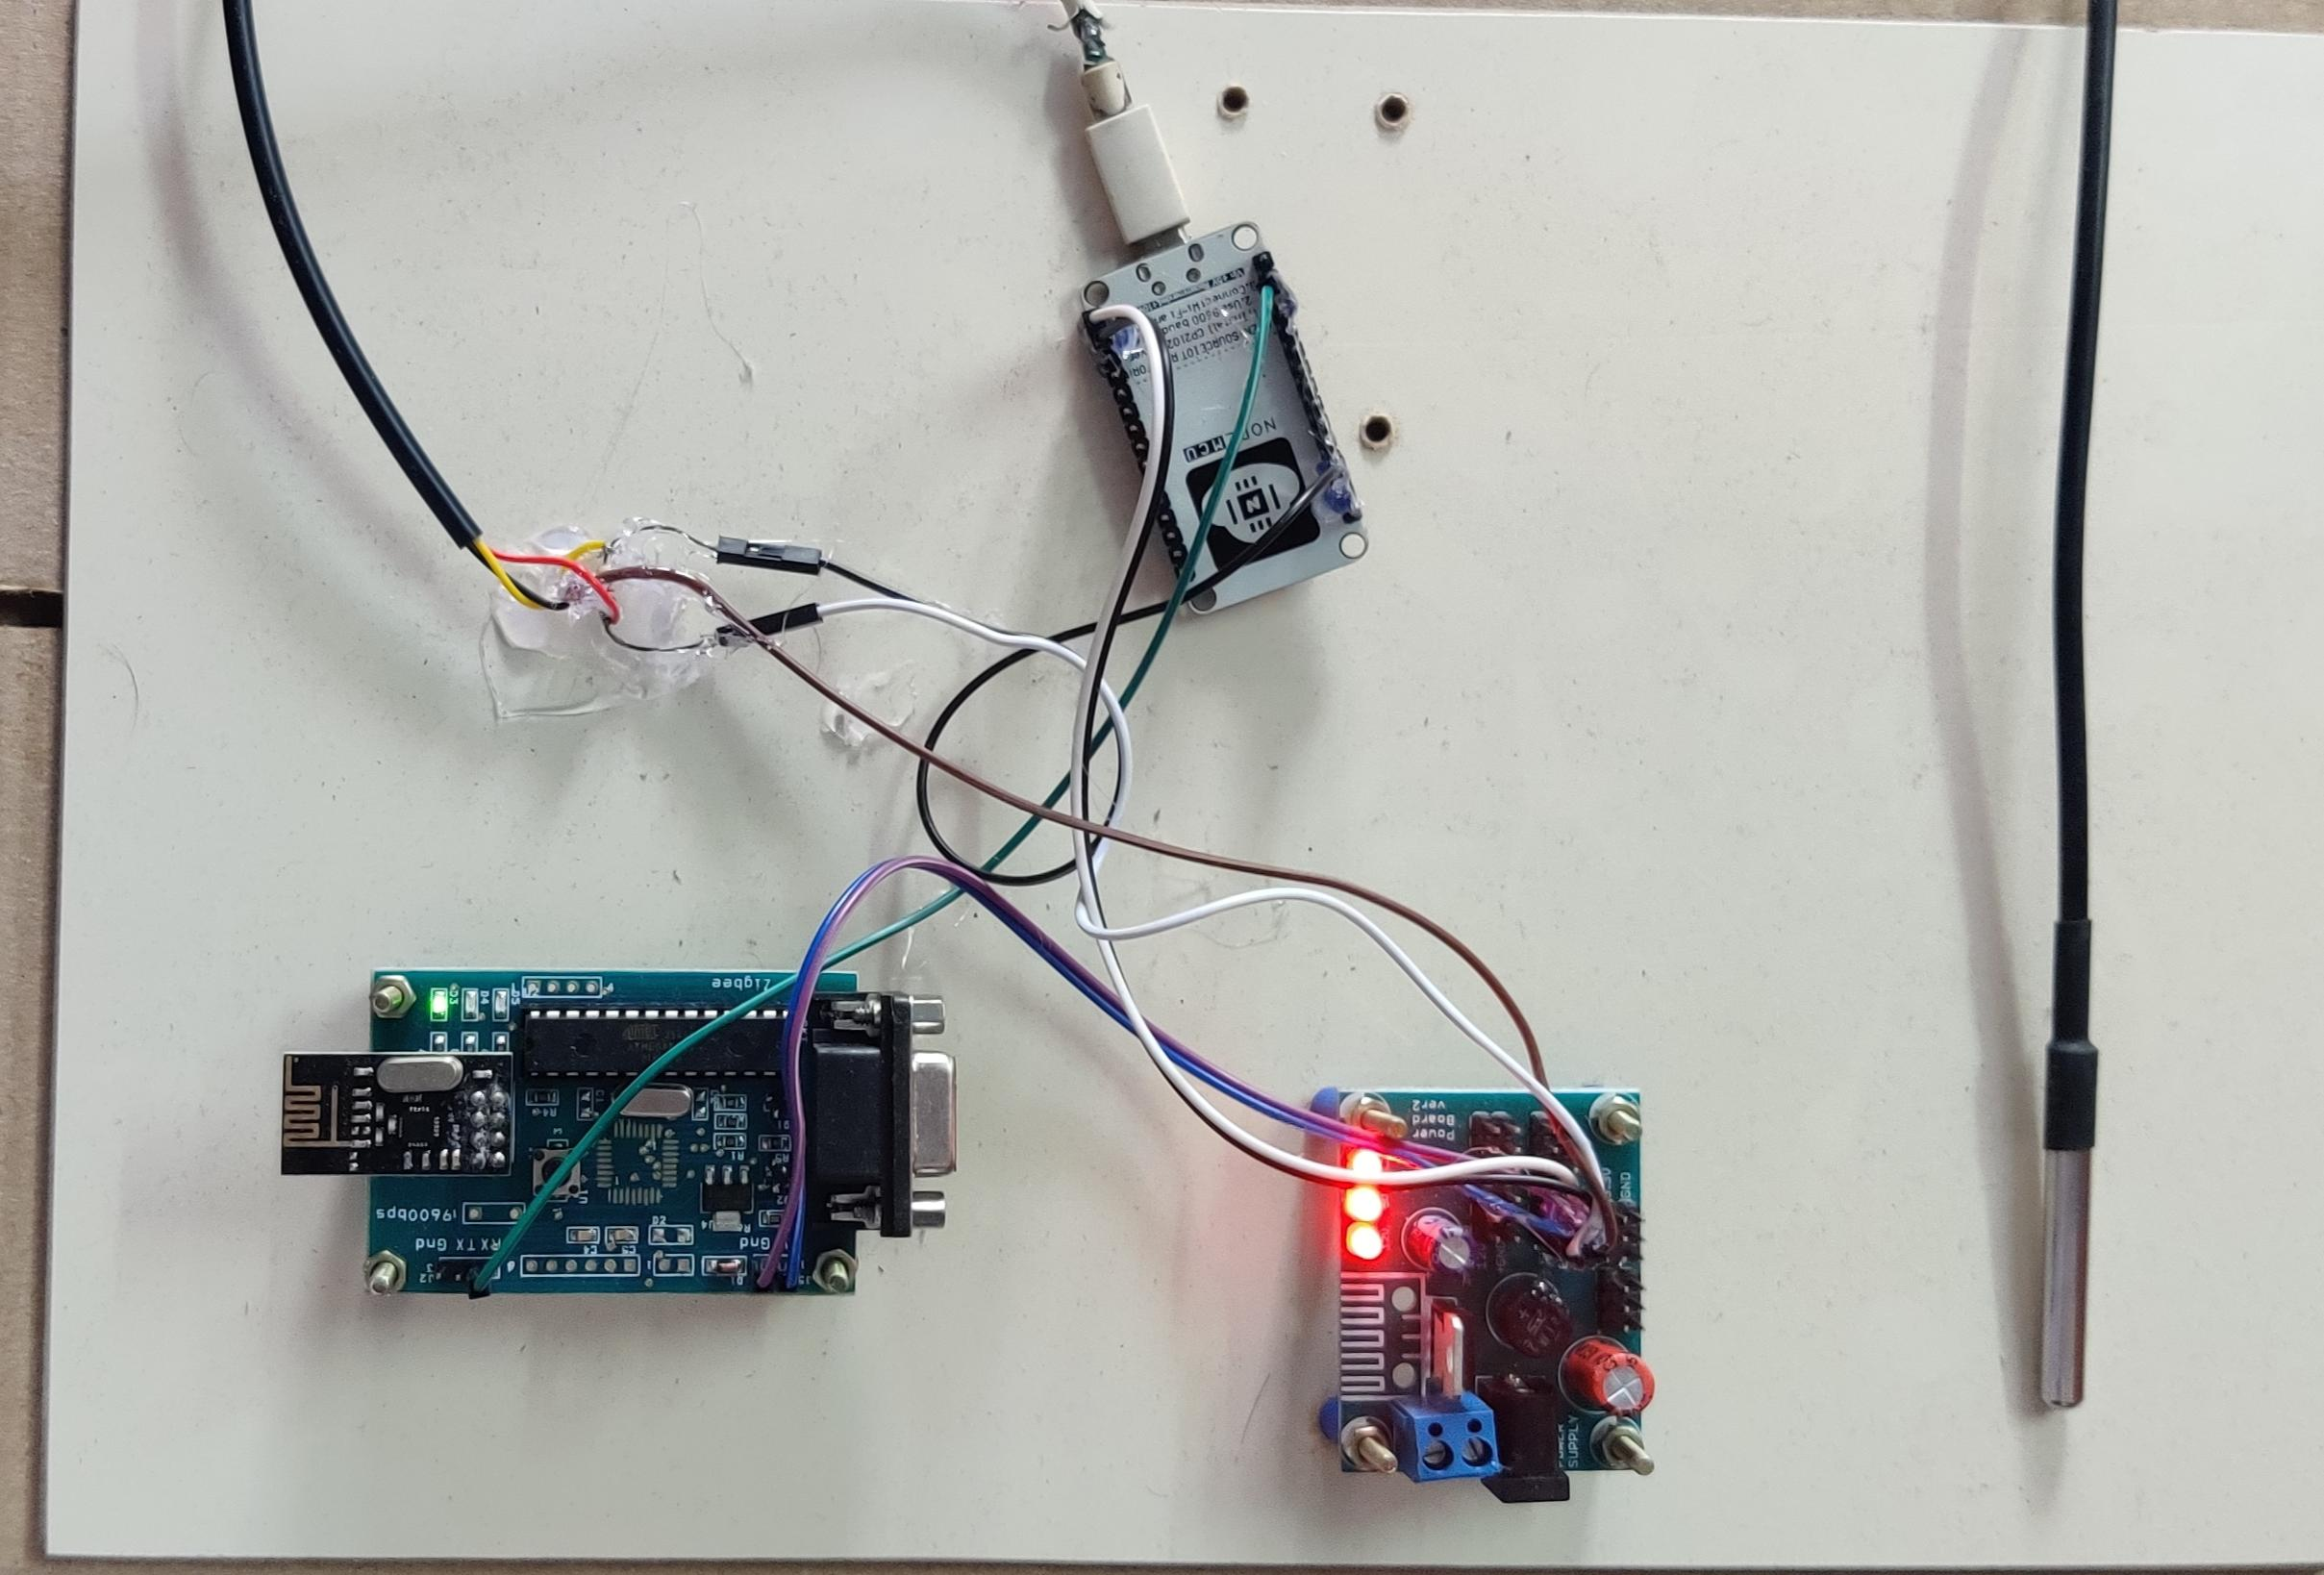
SCREENSHOTS :
Upper Body Module

Slide 19
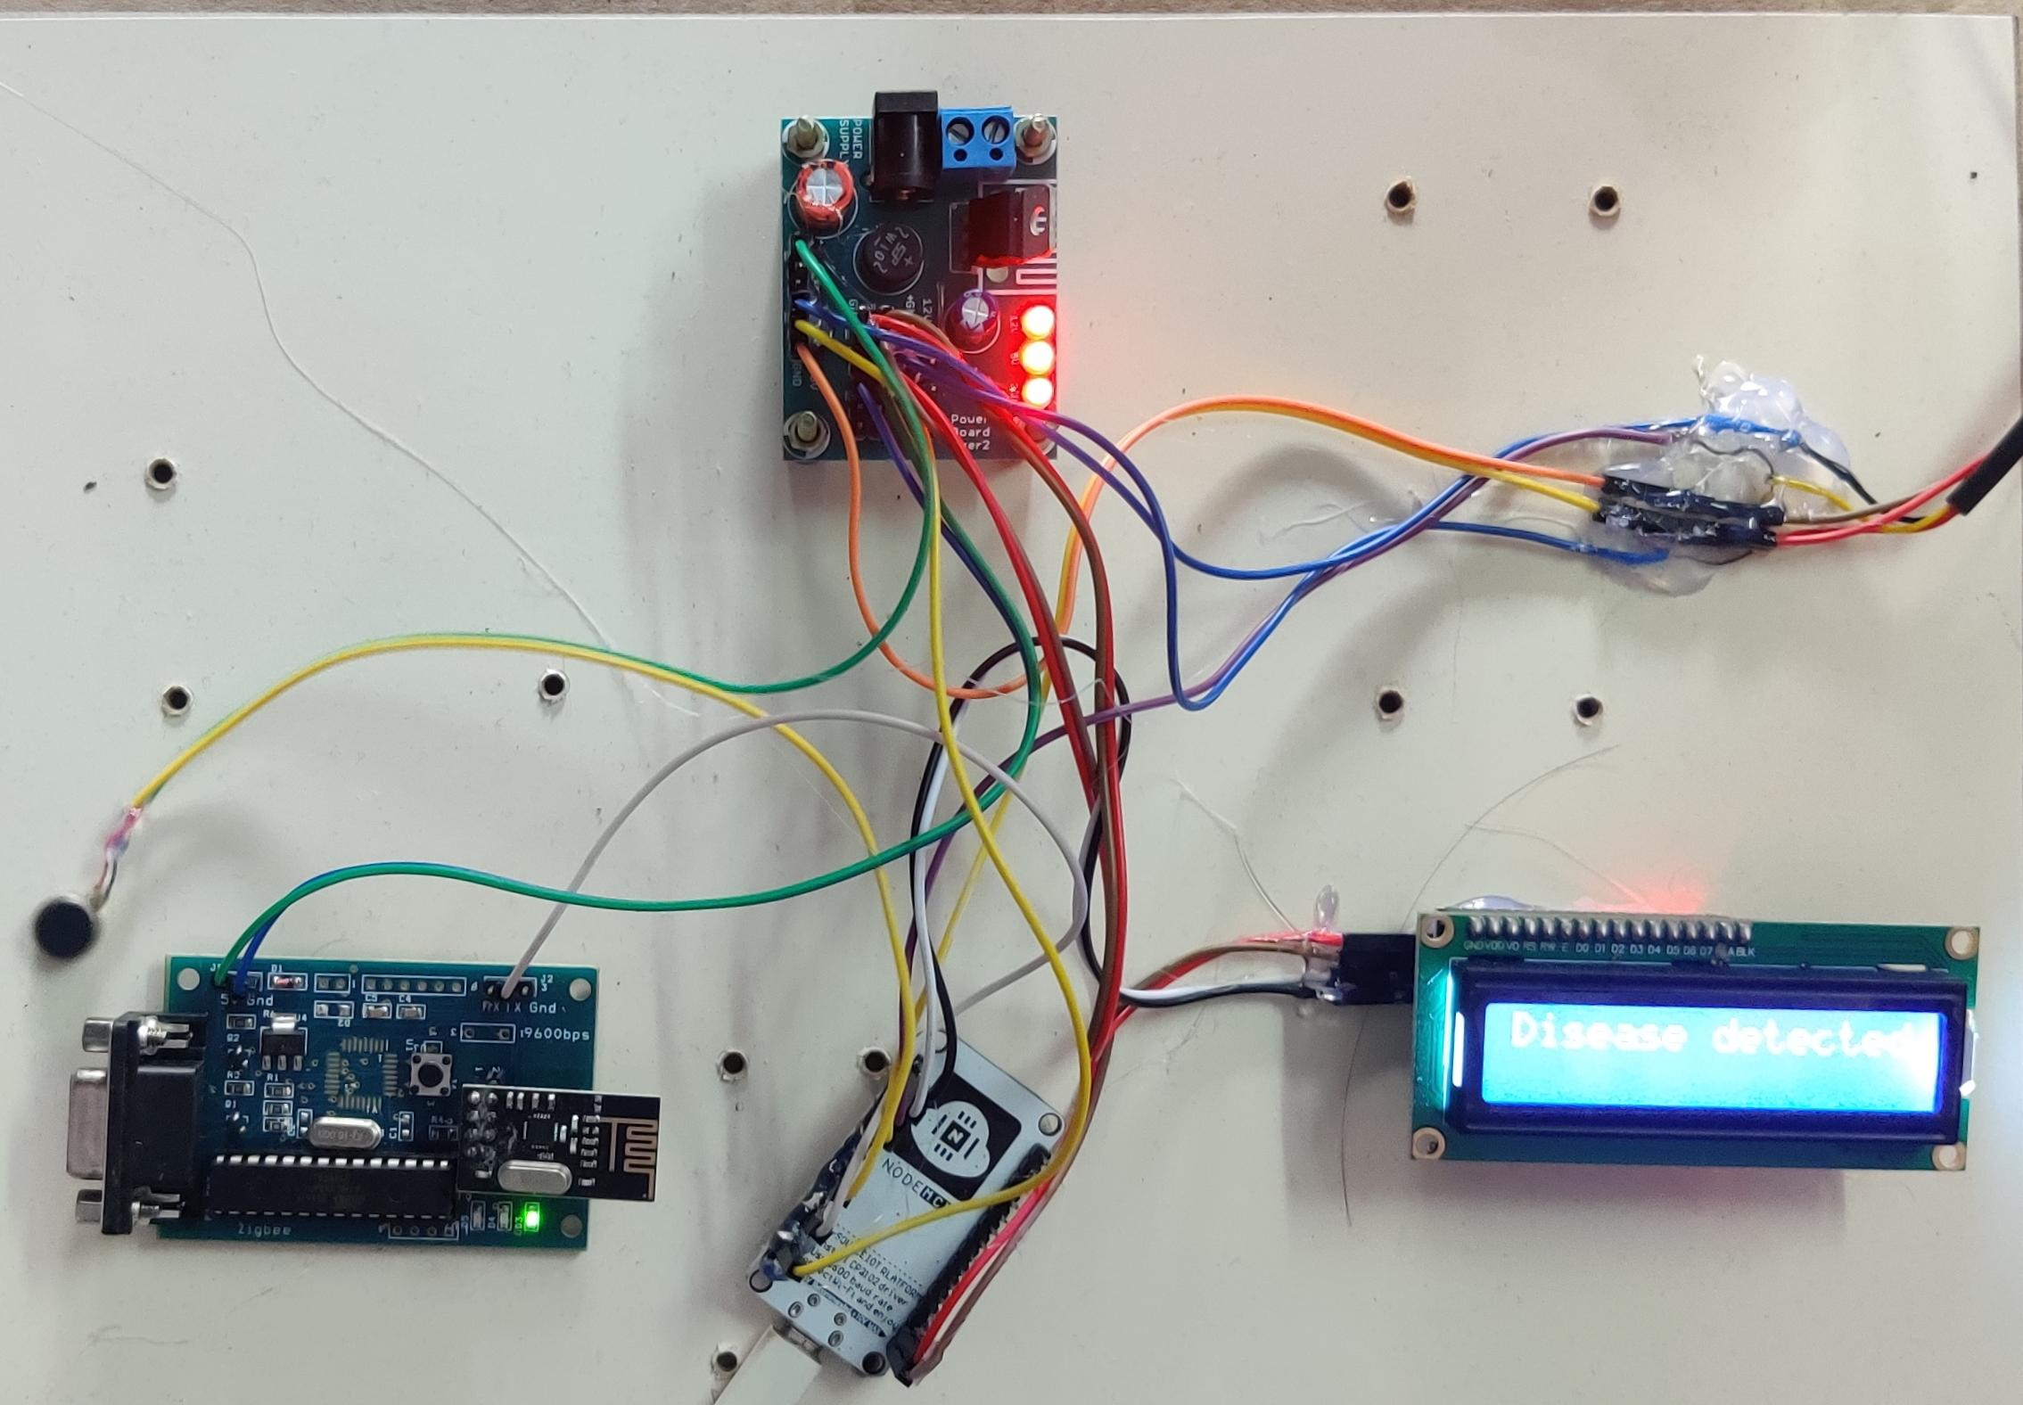
Lower Body Module

Slide 20
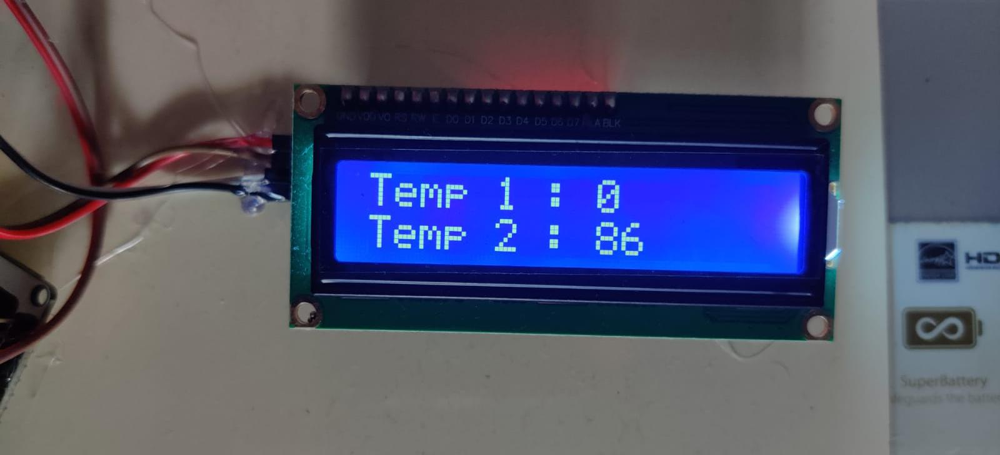
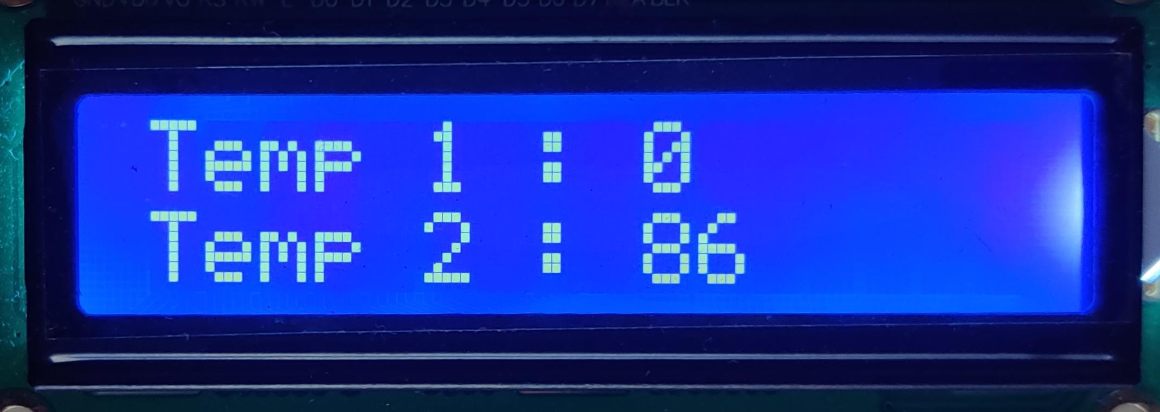
Temperature

Slide 21
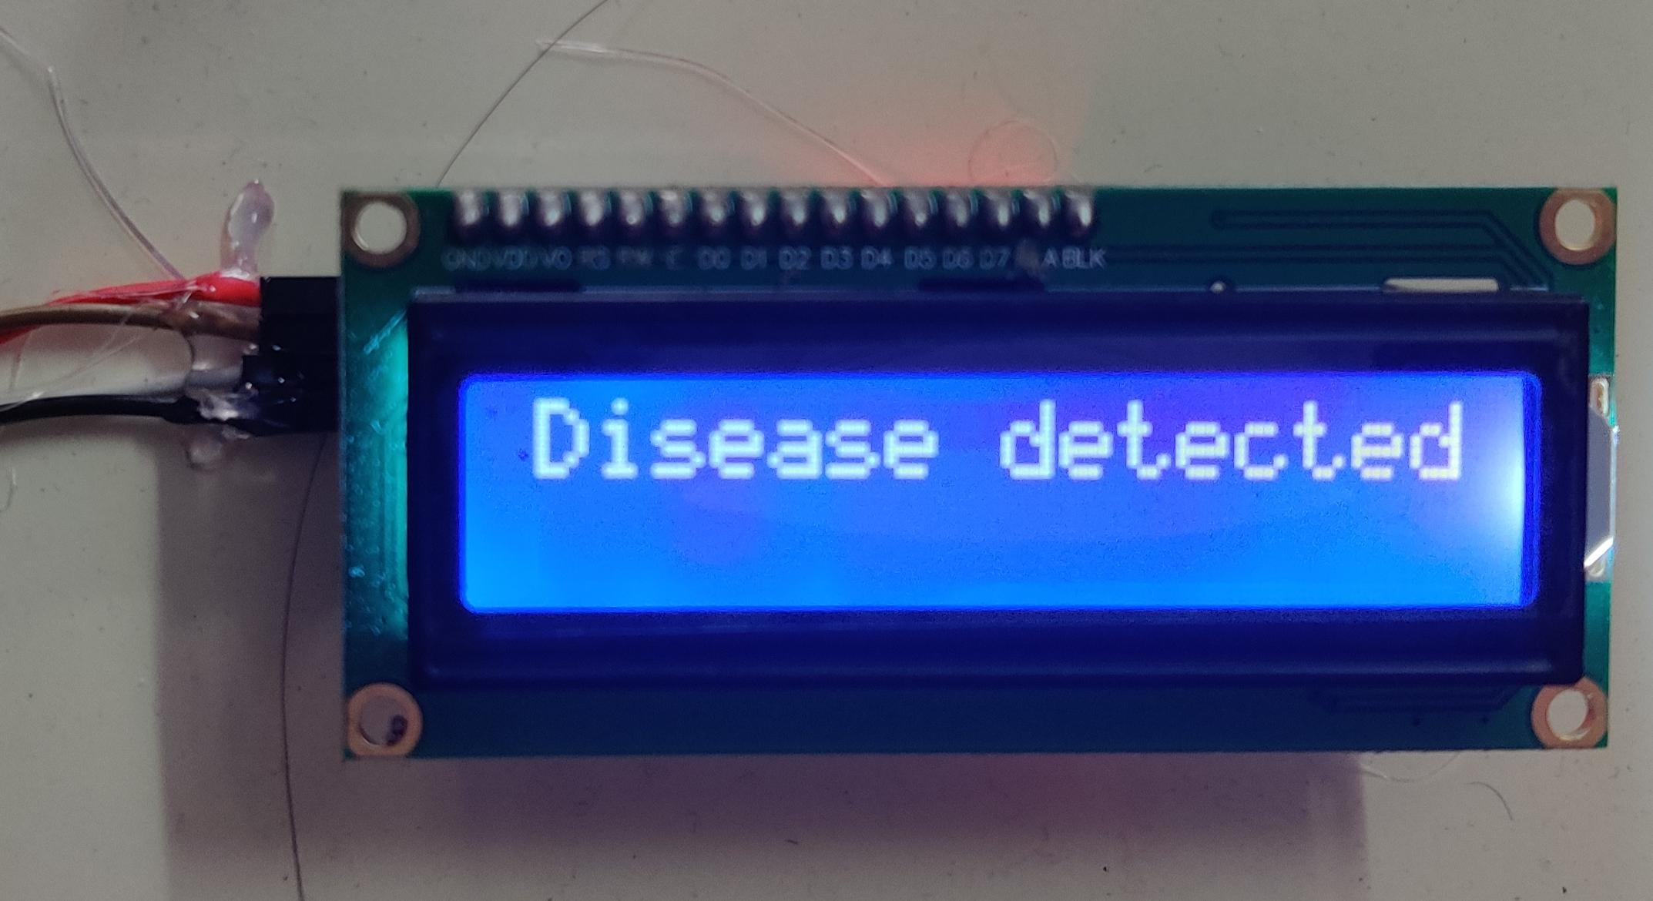
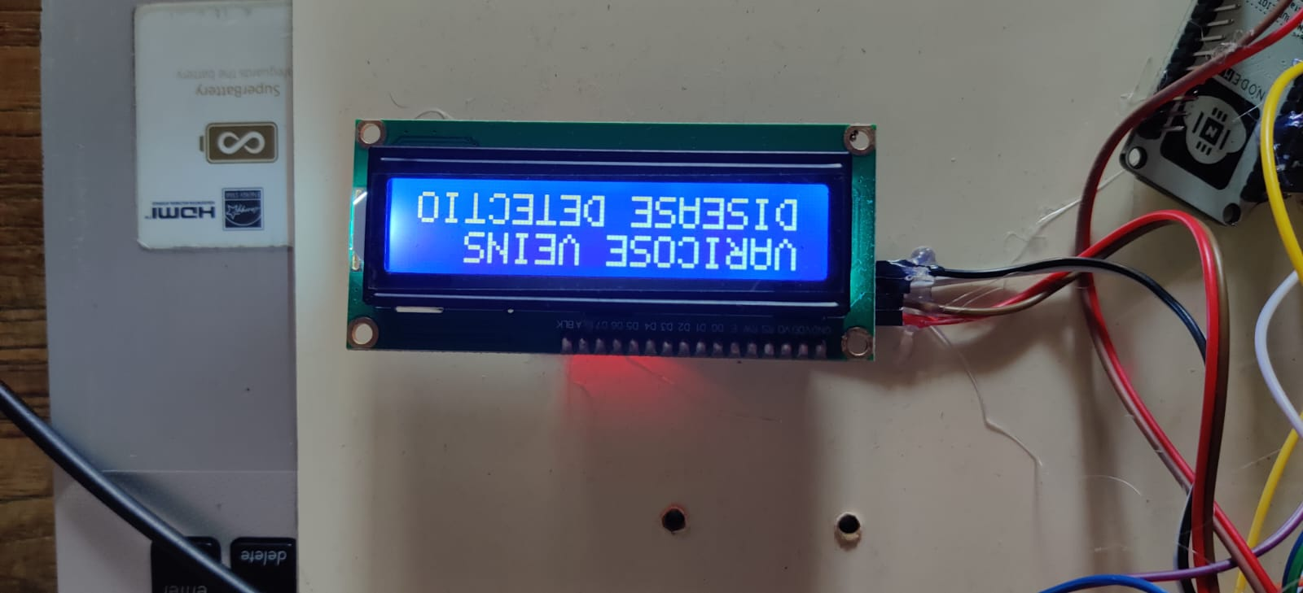
Varicose vein disease detected

Slide 22
CONCLUSION
In conclusion, the use of Body Area Networks (BAN) in the detection and treatment of varicose veins is a promising approach. The proposed system that uses a thermistor sensor and a pressure sensor to detect abnormalities and provide temporary relief to patients suffering from varicose veins is a non-invasive, easy-to-use, and effective approach. The system collects realtime data that can be used for further analysis and diagnosis, enabling healthcare providers to provide personalized and effective treatment options. However, further research is needed to explore the full potential of this system and to develop more advanced and automated treatment options. In the future, the proposed system can be enhanced by incorporating additional sensors and features to provide more personalized treatment options. For example, the system can be equipped with a heart rate monitor to detect changes in heart rate, which can be used to monitor the patient's stress levels and provide stressrelieving treatments. The system can also be integrated with a mobile app that enables patients to monitor their symptoms and receive personalized treatment recommendations. Furthermore, the system can be enhanced by using machine learning algorithms to analyze the collected data and provide more accurate diagnosis and treatment recommendations. With further advancements in technology, BAN-based systems have the potential to revolutionize the detection and treatment of varicose veins and other medical conditions.

Slide 23
REFERENCES
[1] Md Jahid Hasan, Mohammad Ali Khalighi, Volker Jungnickel, Luis Nero Alves, Bastien Be´chadergue, “An Energy- Efficient Optical Wireless OFDMA Scheme for Medical Body-Area Networks”, IEEE Transactions on Green Communications and Networking.
[2] O. Shumkov, M. Smagin, V. Nimaev, A. Sadovskii,“ Radiofrequency ablation of varicose veins in obese patients",International Multiconference Bioinformatics of Genome Regulation and Structure\Systems Biology, 2018.
[3] O. Haddad, M. A. Khaleghi, S. Zvanovec, and M. Adel, “Channel characterization and modeling for optical wireless body-area networks,” IEEE Open Journal of the Communications Society, vol. 1, pp. 760–776, June 2020.
[4] Ruizong Zhu , Huiping Niu , Ningning Yin , Tianjiao Wu , And Yapei Zhao," Analysis of Varicose Veins of Lower Extremities Based on Vascular Endothelial Cell Inflammation Images and Multi-Scale Deep Learning",Dec. 2019.
[5] S. Movassaghi, M. Abolhasan, J. Lipman, D. Smith, and A. Jamalipour, “Wireless body area networks: A survey,” IEEE Communications Surveys & Tutorials, vol. 16, no. 3, pp. 1658– 1686, Mar. 2014.
[6] A. S. Borde, G. V. Savrasov "Mathematical modeling of varicose veins ultrasound heating", IEEE International Conference on Microwaves, Antennas, Communications and Electronic Systems,(COMCAS), 2019.
[7]. B. Latre´, B. Braem, I. Moerman, C. Blondia, and P. Demeester, “A survey on wireless body area networks,” Wireless Networks, vol. 17, no. 1, pp. 1–18, Jan. 2011.
[8] Gennady Victorovich Savrasov, Alexander Vasilyevich Gavrilenko, Anna Sergeevna Borde, Nikita Vladimirovich Belikov, Irina Vitalyevna Khaydukova, Irina Alexandrovna Seliverstova, "Comparison of Mechanical Parameters of the Great Saphenous Vein under Various Test Conditions", Ural Symposium on Biomedical Engineering, Radioelectronics and Information Technology (USBEREIT), 2019.
[9] O. Haddad, M. A. Khalighi, and S. Zvanovec, “Channel characterization for optical extra-WBAN links considering local and global user mobility,” in Broadband Access Communication Technologies XIV, B. B. Dingel, K. Tsukamoto, and S. Mikroulis, Eds., vol. 11307, International Society for Optics and Photonics. SPIE, 2020, pp. 89 – 97.

Slide 24
[10] Jing Liu, Bryan Yan, Shih-Chi Chen, Yuan-Ting Zhang, Fellow, Charles Sodini, Fellow, and Ni Zhao, "Non-Invasive Capillary Blood Pressure Measurement Enabling Early Detection and Classification of Venous Congestion",2021.
[11] M. J. Hasan, M. A. Khalighi, J. Garca- Mrquez, and B. Bchadergue, “Performance analysis of optical-CDMA for uplink transmission in medical extra- WBANs,” IEEE Access, vol. 8, pp. 171 672–171 685,Sept. 2020.
[12] Z. Ghassemlooy, L. N. Alves, S. Zvanovec, and M. A. Khalighi, Eds., Visible Light Communications: Theory and Applications. CRC Press, 2017.
[13] M. Giordani, M. Polese, M. Mezzavilla, S. Rangan, and M. Zorzi, “To- ward 6G networks: Use cases and technologies,” IEEE Communications Magazine, vol. 58, no. 3, pp. 55–61, Mar. 2020.
[14] O. Haddad and M. A. Khalighi, “Enabling communication technologies for medical wireless body-area networks,” in Global LiFi Congress (GLC), June 2019, pp. 1–5, Paris, France.
[15] T. B. Hoang, S. Sahugue`de, and A. Julien-Vergonjanne, “Optical wire- less network design for off-body-sensor based monitoring,” Wireless Communications and Mobile Computing, vol. 2019, p. 13, Sep. 2019.
[16] P. K. Plunkett, D. G. Byrne, T. Breslin, K. Bennett, and B. Silke, “Increasing wait times predict increasing mortality for emergency medical admissions,” European Journal of Emergency Medicine, vol. 18, pp. 192– 196, Aug. 2011.

